Slide 1

Chapter 9 The Priority Queue ADT

Slide 2
Chapter 9: The Priority Queue ADT
9.1 – The Priority Queue Interface
9.2 – Priority Queue Implementations
9.3 – The Heap
9.4 – The Heap Implementation

Slide 3
9.1 The Priority Queue Interface
A priority queue is an abstract data type with an interesting accessing protocol - only the highest-priority element can be accessed
Priority queues are useful for any application that involves processing items by priority

Slide 4
The Interface
package ch09.priorityQueues;
public interface PriQueueInterface<T>
{
void enqueue(T element);
// Throws PriQOverflowException if this priority queue is full;
// otherwise, adds element to this priority queue.
T dequeue();
// Throws PriQUnderflowException if this priority queue is empty;
// otherwise, removes element with highest priority from this
// priority queue and returns it.
boolean isEmpty();
// Returns true if this priority queue is empty; otherwise, returns false.
boolean isFull();
// Returns true if this priority queue is full; otherwise, returns false.
int size();
// Returns the number of elements in this priority queue. }

Slide 5
9.2 Priority Queue Implementations
There are many ways to implement a priority queue
An Unsorted List - dequeuing would require searching through the entire list
An Array-Based Sorted List - Enqueuing is expensive
A Sorted Linked List - Enqueuing again is 0(N)
A Binary Search Tree - On average, 0(log₂N) steps for both enqueue and dequeue
A Heap - (next section) guarantees 0(log₂N) steps, even in the worst case

Slide 6
9.3 The Heap
Heap An implementation of a Priority Queue based on a complete binary tree, each of whose elements contains a value that is greater than or equal to the value of each of its children
In other words, a heap is an implementation of a Priority Queue that uses a binary tree that satisfies two properties
the shape property: the tree must be a complete binary tree
the order property: for every node in the tree, the value stored in that node is greater than or equal to the value in each of its children.

Slide 7


Tree Terminology
A full binary tree
A complete binary tree

Slide 8
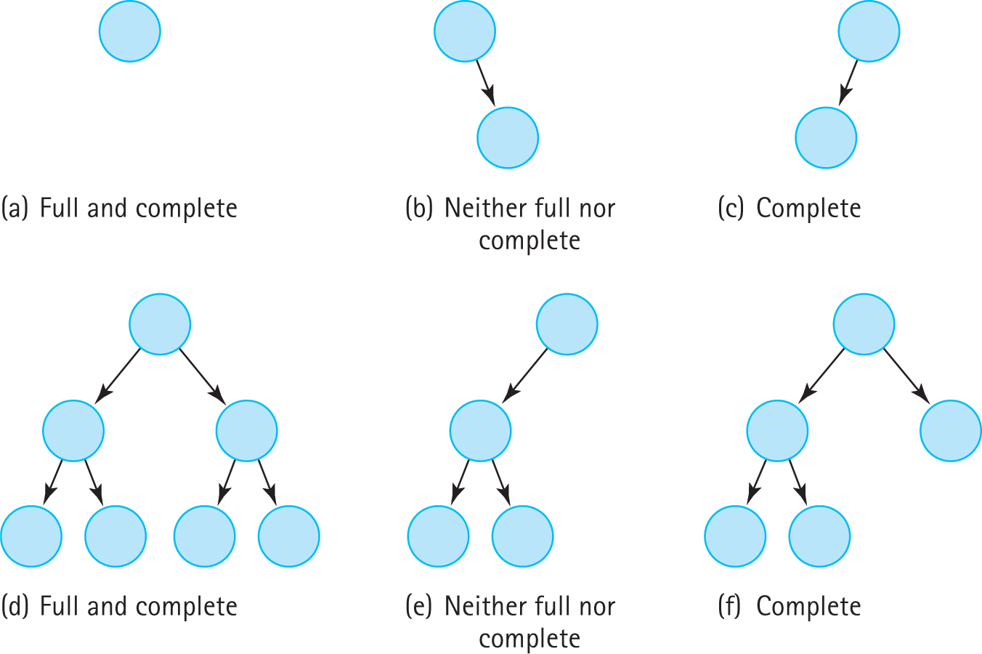
Examples

Slide 9
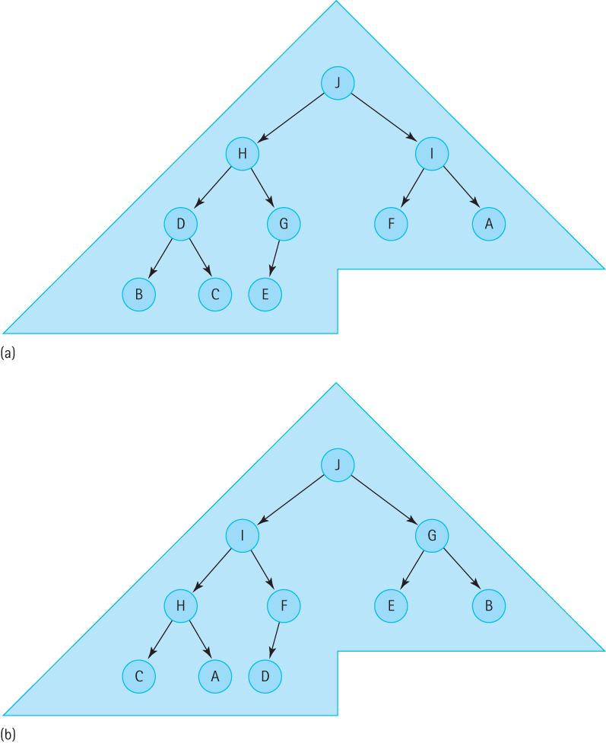
Two Heaps Containing the Letters ‘A’ through ‘J’

Slide 10
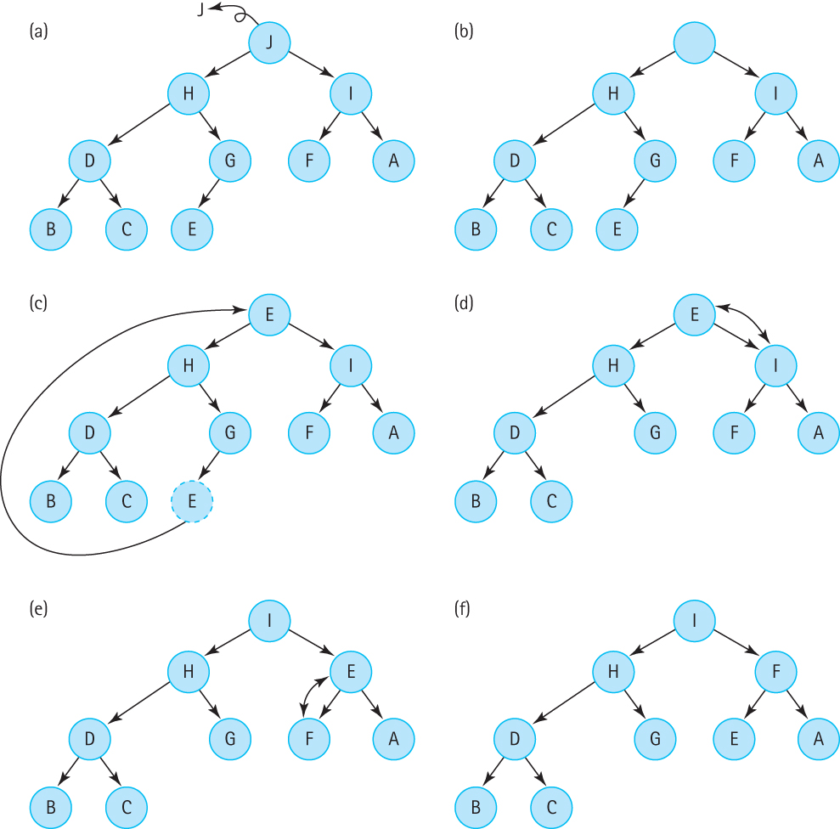
The dequeue operation Steps d,e,f represent the “reheap down” operation

Slide 11
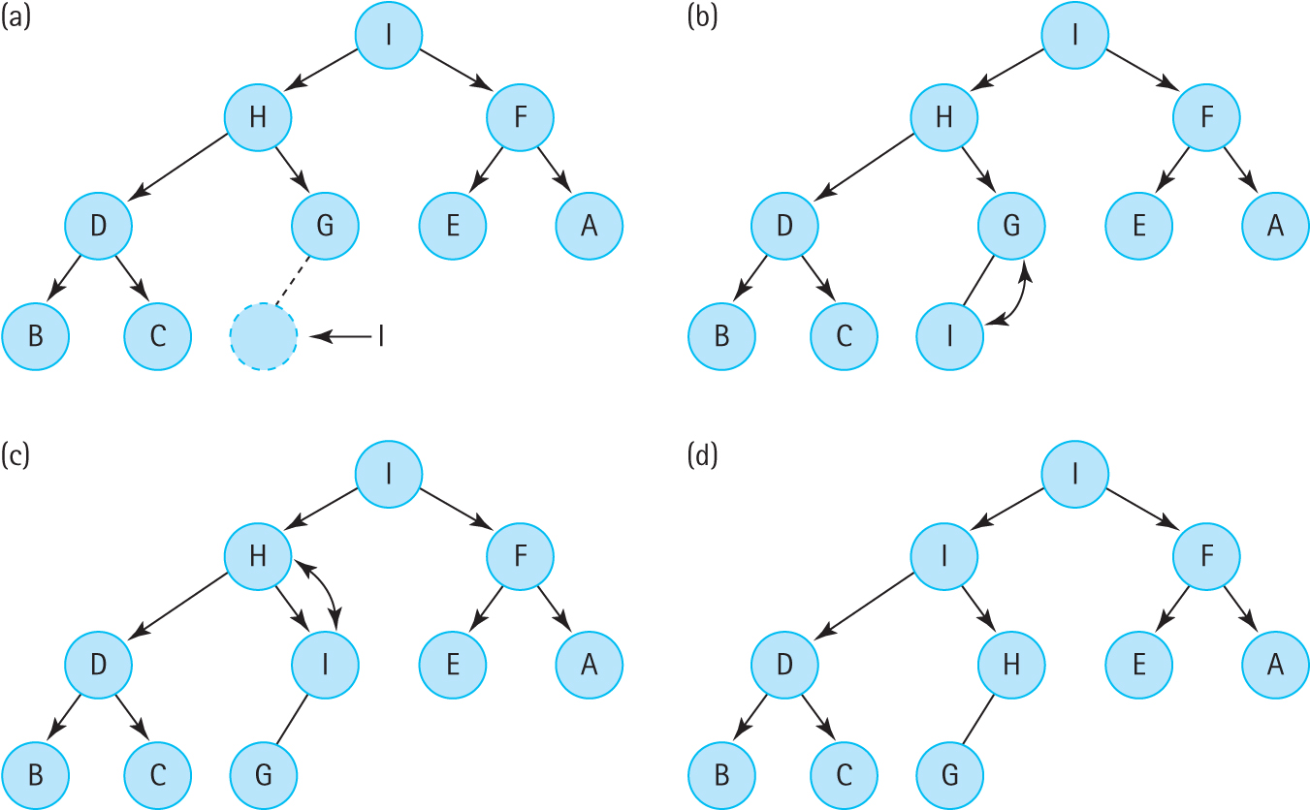
The enqueue operation steps b, c represent the “reheap up” operation

Slide 12
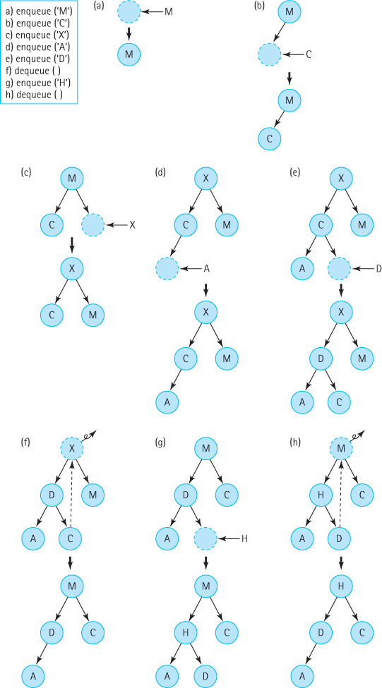

Slide 13
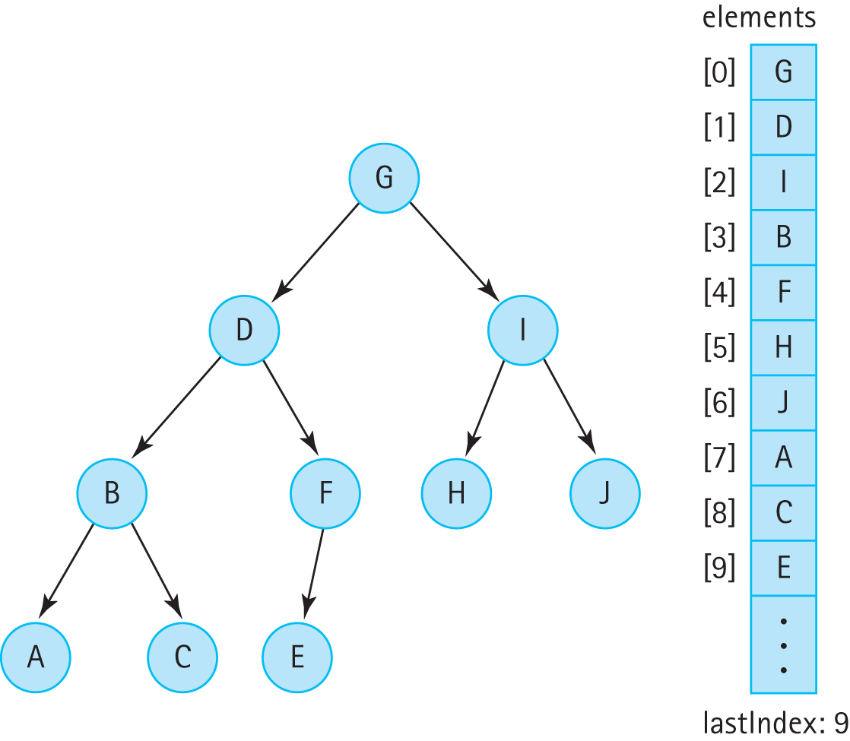
9.4 The Heap Implementation

Slide 14
A Non-linked Representation of Binary Trees
A binary tree can be stored in an array in such a way that the relationships in the tree are not physically represented by link members, but are implicit in the algorithms that manipulate the tree stored in the array.
We store the tree elements in the array, level by level, left-to-right. We call the array elements and store the index of the last tree element in a variable lastIndex.
The tree elements are stored with the root in elements[0] and the last node in elements[lastIndex].

Slide 15
A Binary Tree and Its Array Representation

Slide 16
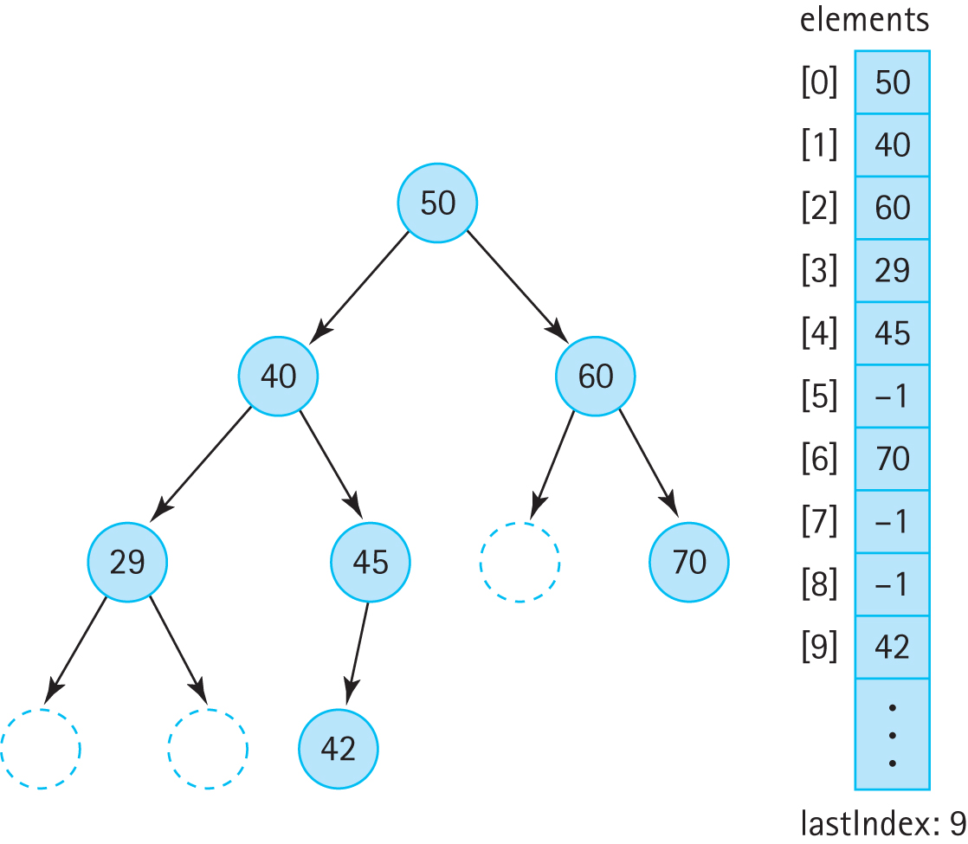
A Binary Search Tree Stored in an Array with Dummy Values

Slide 17
Array Representation continued
To implement the algorithms that manipulate the tree, we must be able to find the left and right child of a node in the tree:
elements[index] left child is in elements[index*2 + 1]
elements[index] right child is in elements[index*2 + 2]
We can also can determine the location of its parent node:
elements[index]’s parent is in elements[(index – 1)/2].
This representation works best, space wise, if the tree is complete (which it is for a heap)

Slide 18
Beginning of HeapPriQ.java
//-------------------------------------------------------------------------
// HeapPriQ.java by Dale/Joyce/Weems Chapter 9 // Priority Queue using Heap (implemented with an ArrayList)
//
// Two constructors are provided: one that use the natural order of the
// elements as defined by their compareTo method and one that uses an
// ordering based on a comparator argument.
//-------------------------------------------------------------------------
package ch09.priorityQueues;
import java.util.*; // ArrayList, Comparator
public class HeapPriQ<T> implements PriQueueInterface<T>
{
protected ArrayList<T> elements; // priority queue elements
protected int lastIndex; // index of last element in priority queue
protected int maxIndex; // index of last position in ArrayList
protected Comparator<T> comp;
. . .

Slide 19
The enqueue method
public void enqueue(T element) throws PriQOverflowException
// Throws PriQOverflowException if this priority queue is full;
// otherwise, adds element to this priority queue.
{
if (lastIndex == maxIndex)
throw new PriQOverflowException("Priority queue is full");
else
{
lastIndex++;
elements.add(lastIndex, element);
reheapUp(element);
}
}
The reheapUp algorithm is pictured on the next slide

Slide 20
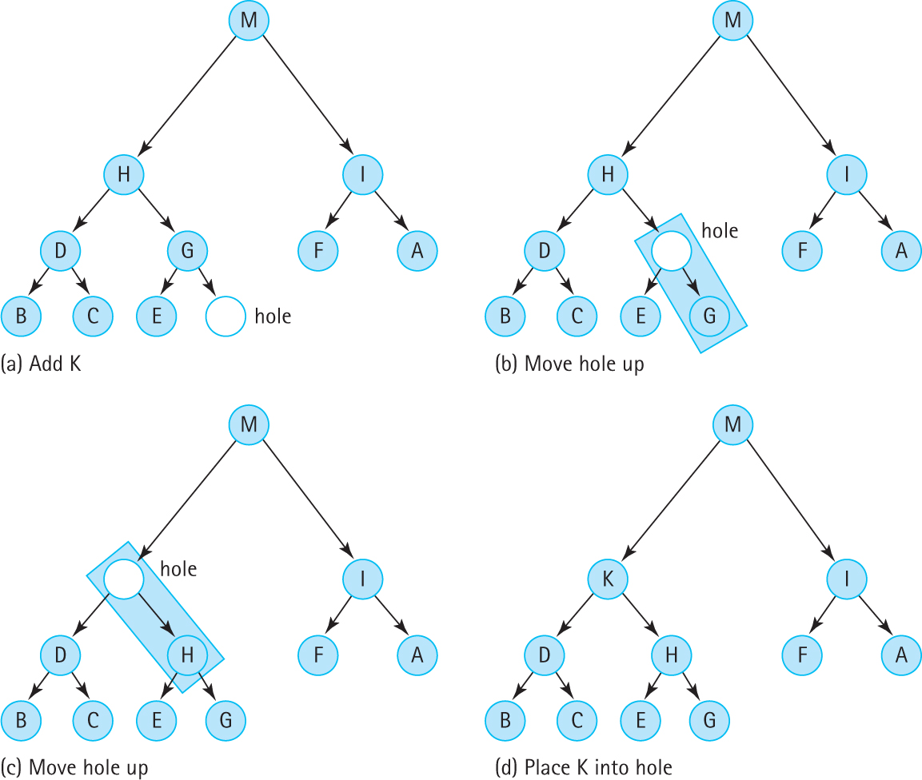

Slide 21
reheapUp operation
private void reheapUp(T element)
// Current lastIndex position is empty.
// Inserts element into the tree and ensures shape and order properties.
{
int hole = lastIndex;
while ((hole > 0) // hole is not root and element > hole's parent
&&
(comp.compare(element, elements.get((hole - 1) / 2)) > 0))
{
elements.set(hole,elements.get((hole - 1) / 2)); // move hole's parent down
hole = (hole - 1) / 2; // move hole up
}
elements.set(hole, element); // place element into final hole
}

Slide 22
The dequeue method
public T dequeue() throws PriQUnderflowException
// Throws PriQUnderflowException if this priority queue is empty;
// otherwise, removes element with highest priority from this
// priority queue and returns it.
{
T hold; // element to be dequeued and returned
T toMove; // element to move down heap
if (lastIndex == -1)
throw new PriQUnderflowException("Priority queue is empty");
else
{
hold = elements.get(0); // remember element to be returned
toMove = elements.remove(lastIndex); // element to reheap down
lastIndex--; // decrease priority queue size
if (lastIndex != -1)
reheapDown(toMove); // restore heap properties
return hold; // return largest element
}
}
The reheapDown algorithm is pictured on the next slide

Slide 23
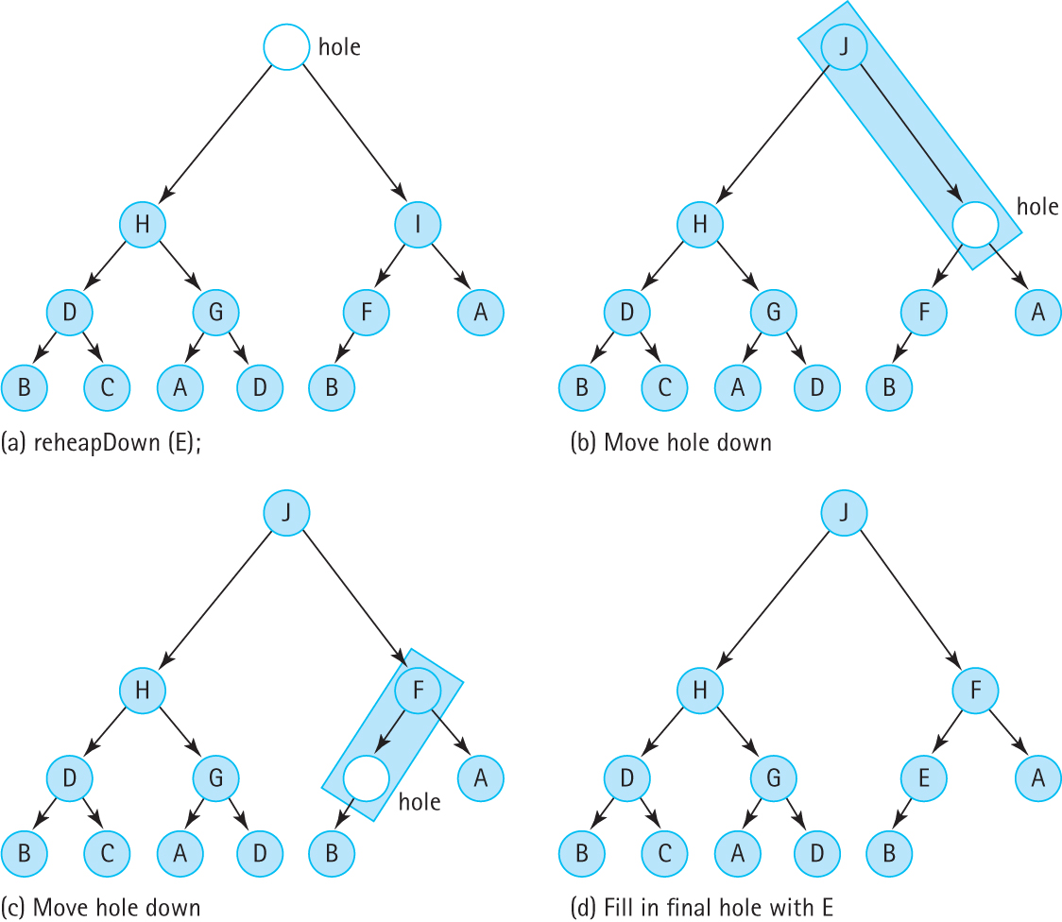

Slide 24
reheapDown operation
private void reheapDown(T element)
// Current root position is "empty";
// Inserts element into the tree and ensures shape and order properties.
{
int hole = 0; // current index of hole
int next; // next index where hole should move to
next = newHole(hole, element); // find next hole
while (next != hole)
{
elements.set(hole,elements.get(next)); // move element up
hole = next; // move hole down
next = newHole(hole, element); // find next hole
}
elements.set(hole, element); // fill in the final hole
}

Slide 25
The newHole method
private int newHole(int hole, T element)
// If either child of hole is larger than element return the index
// of the larger child; otherwise return the index of hole.
{
int left = (hole * 2) + 1;
int right = (hole * 2) + 2;
if (left > lastIndex)
// hole has no children
return hole;
else
if (left == lastIndex)
// hole has left child only
if (comp.compare(element, elements.get(left)) < 0)
// element < left child
return left;
else
// element >= left child
return hole;
else
// hole has two children
if (comp.compare(elements.get(left), elements.get(right)) < 0)
// left child < right child
if (comp.compare(elements.get(right), element) <= 0)
// right child <= element
return hole;
else
// element < right child
return right;
else
// left child >= right child
if (comp.compare(elements.get(left), element) <= 0)
// left child <= element
return hole;
else
// element < left child
return left;
}

Slide 26
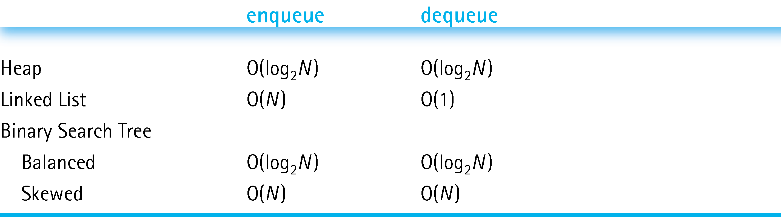
Heaps Versus Other Representations of Priority Queues

